Slide 1

Name : Mahasen
Email : mahasen2101@gmail.com
Project Title : Doctor Visit Analysis using Python

Slide 2
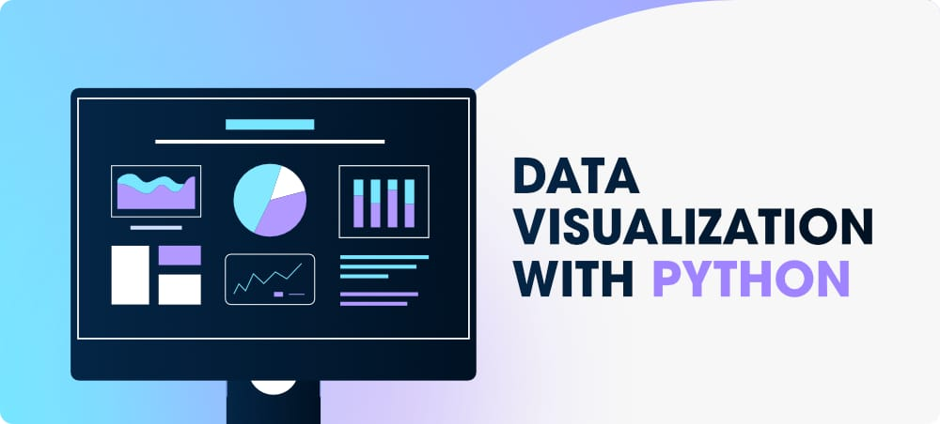
DOCTOR VISIT ANALYSIS USING PYTHON

Slide 3
PROJECT TOPIC
"Predictive Modeling for Patient Readmission Risk in a Hospital Setting"
In this project, the goal would be to analyze a doctor dataset and develop a predictive model to estimate the likelihood of a patient being readmitted to the hospital within a specified time frame. By exploring factors such as patient demographics, medical history, treatments, and hospitalization details, the project would aim to identify significant predictors of readmission and build a machine learning model to make accurate predictions.

Slide 4
AGENDA
Data Collection: Gather doctor visit data, including patient demographics, visit details, diagnoses, and treatments.
Data Preprocessing: Clean and preprocess the dataset, handling missing values, outliers, and ensuring data consistency.
Exploratory Data Analysis (EDA): Perform descriptive statistics and visualizations to gain insights into visit patterns, patient characteristics, and common diagnoses.
Analysis and Insights: Apply statistical techniques and data mining algorithms to identify trends, patterns, and correlations in the data, providing actionable insights for improving healthcare delivery.
Visualization and Reporting: Present findings through informative visualizations and a concise report summarizing the analysis results and key takeaways.

Slide 5

PROJECT OVER VIEW
This project analyzes doctor visit data using Python to gain insights into patient behavior, medical diagnosis, and treatment patterns. It aims to uncover trends and correlations, providing actionable insights for improving healthcare delivery and optimizing resource allocation.

Slide 6

WHO ARE THE END USERS
The potential end users of the doctor visit analysis project include healthcare administrators and medical practitioners, who can utilize the insights to optimizer source allocation, improve healthcare delivery, and enhance patient care.

Slide 7
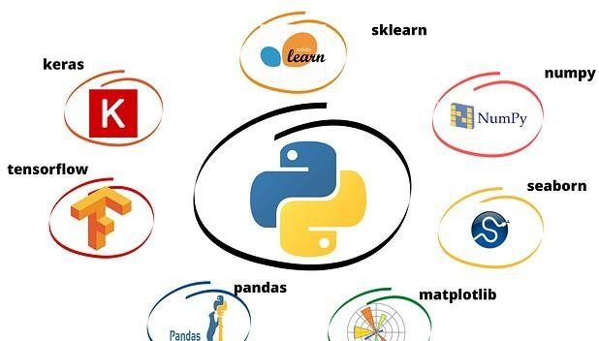
LIBRARIES
NumPy
Pandas
matplotlib
seaborn
.

Slide 8

SOLUTION
The analysis of the doctor dataset aims to gain insights into various factors such as patient demographics, medical conditions, treatments, and outcomes, in order to identify patterns, trends, and correlations. By applying statistical and machine learning techniques, this analysis seeks to optimize patient care, improve medical decision-making, and enhance healthcare system efficiency.

Slide 9

Advantages
Flexibulity
Cost and time savings
Scalability
Data and analytics
Real time monitoring

Slide 10
Links
https://colab.research.google.com/drive/1oIbf4 8uEAfJl95Frsn_okWKcoC4B61-r?usp=sharing

Slide 11

Result
The results of the doctor visit analysis project include insights into patient behavior, identification of common diagnosis, analysis of treatment patterns, resource optimization recommendations, and actionable insights for healthcare administrators and practitioners to enhance patient care and improve healthcare outcomes.

Slide 12


